Slide 1
Exploring Data Sources, Types, and Analysis Tools in Health Analytics
Name: Masixole Boya
Student number: 1869204
Health Analytics (COMS5027A): Activity 1

Slide 2
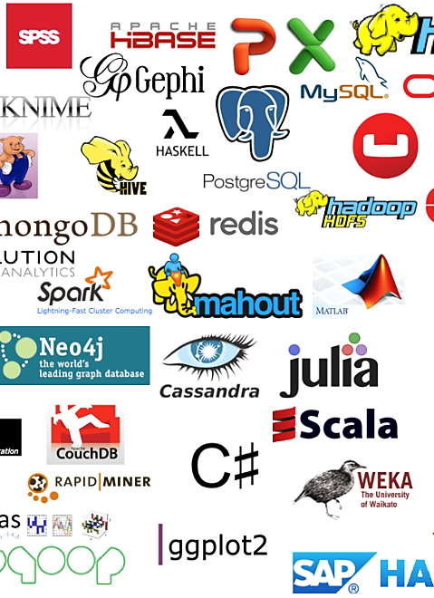
Introduction
Aim:
Investigate various data sources and types prevalent in the health system.
Objectives/ Content:
Explore methods of data analysis
Identify and list the tools or frameworks commonly used for analysing health data.
Discuss one of the tools and frameworks discuss in depth
Use of the chosen tool or framework
Link to a case study.
Types of learning the data, tool, or framework relates to and rationale

Slide 3
Data Sources in health
Surveys
Administrative records
Electronic Medical/Health Records
Healthcare claims data
Disease registries
-National Library of Medicine
https://www.nlm.nih.gov

Slide 4

Data Tools in Health Analytics
Database system
My SQL
Programming Language
SQL
Data Stored
Patient Data
Hospital Data
Research Data
Finance and Insurance Data

Slide 5


Data Tools in Health Analytics
Data Visualization
Tablaeu
Power BI
MS Excel
Python (pandas) and R
Use
Make sense of the data
Graphs
Dashboards

Slide 6
Data Tools in Health Analytics
Computational Frameworks
Scikit-Learn
Tensorflow
Python
Use
Machine Learning
Deep Learning

Slide 7

Data Tools in Health Analytics
Computational Frameworks
Scikit-Learn (Machine Learning)
Decision Trees
Support Vector Machines (SVM)
Neural Networks
Bayesian Network
Advanced Use
Hierachical Clustering
Disease Modelling
Spatio-Temporal

